Slide 1
Functional Testing Service Level Testing

Slide 2
SPEAKER

Slide 3
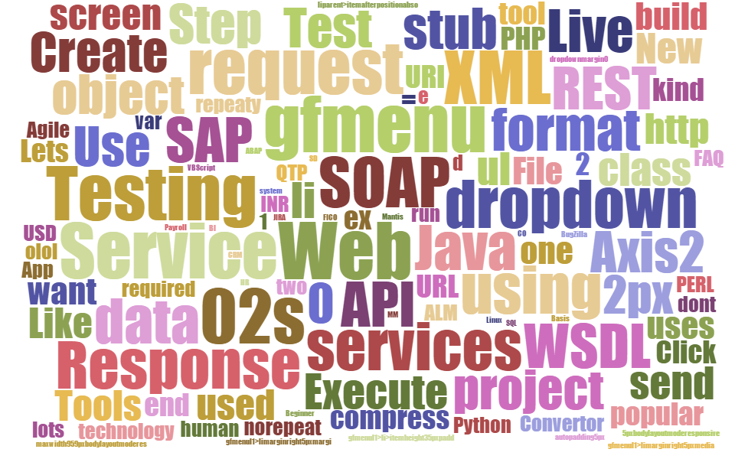
AGENDA
1
Introduction to Service testing
2
SOAP Web Services
3
REST Services / REST APIs
4
Service Testing

Slide 4


Software Architecture Evaluation
User Interface
User Interface
Business Logic
Account Service
Product Service
Order Service
Data Access Layer
Data Access Layer
Database
Database
Database
Database

Slide 5
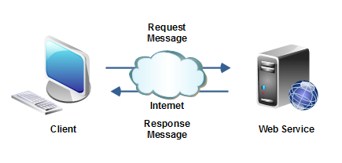
Introduction – Service / API
A service as an interface between two software applications and allows the two software applications to communicate with each other.
A Service is a collection of software functions which can be executed by another software program.
A Service gets the request from the user and gives the response without exposing internal logic.
Primarily we have
SOAP Service
REST Service

Slide 6
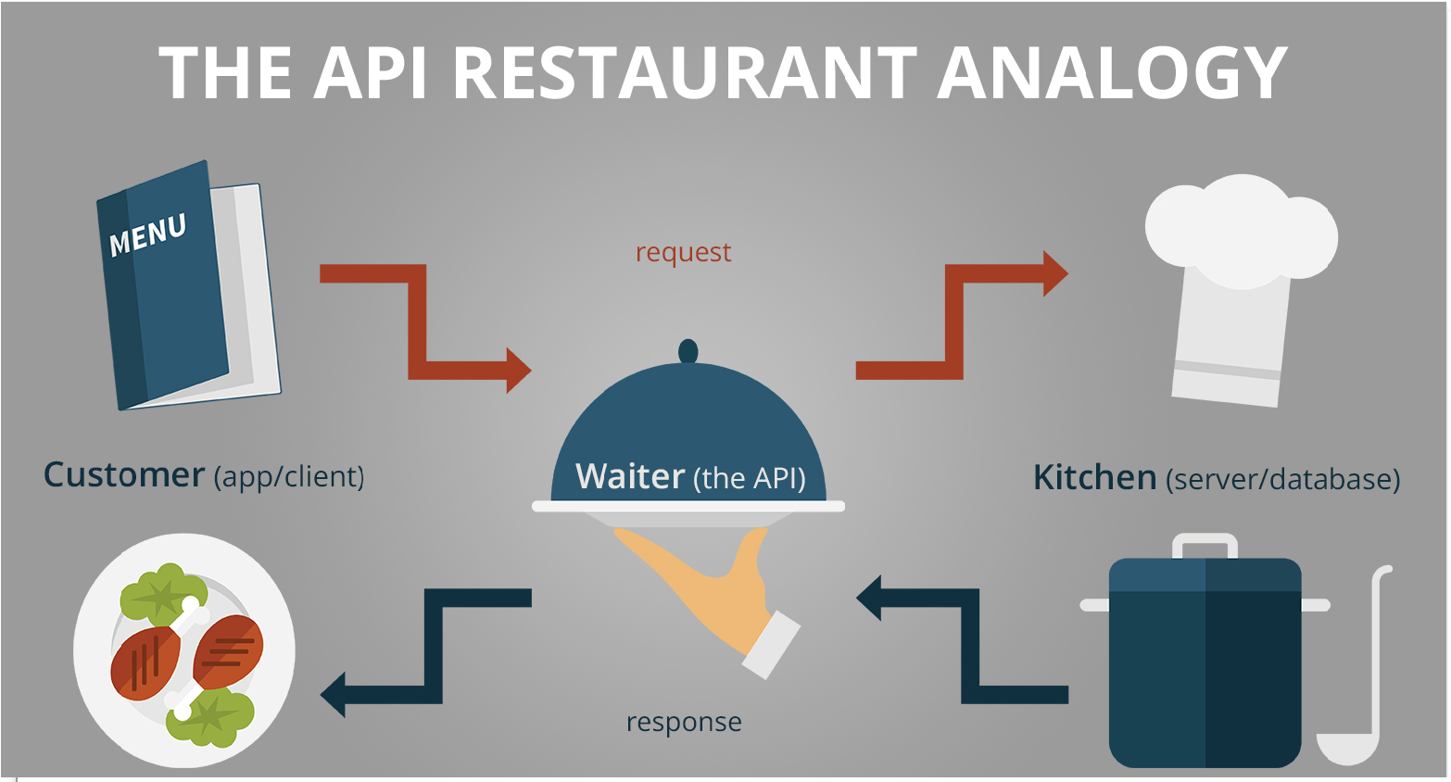
Example – Restaurant Analogy

Slide 7
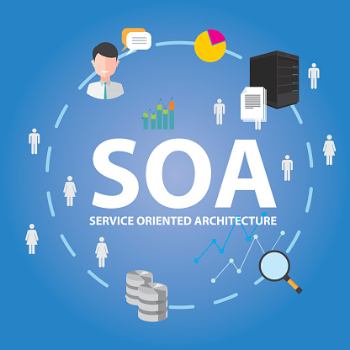
Benefits of Service Oriented Architecture
Reusability
Testability
Interoperability
Platform independence
Parallel development
Better Scalability

Slide 8
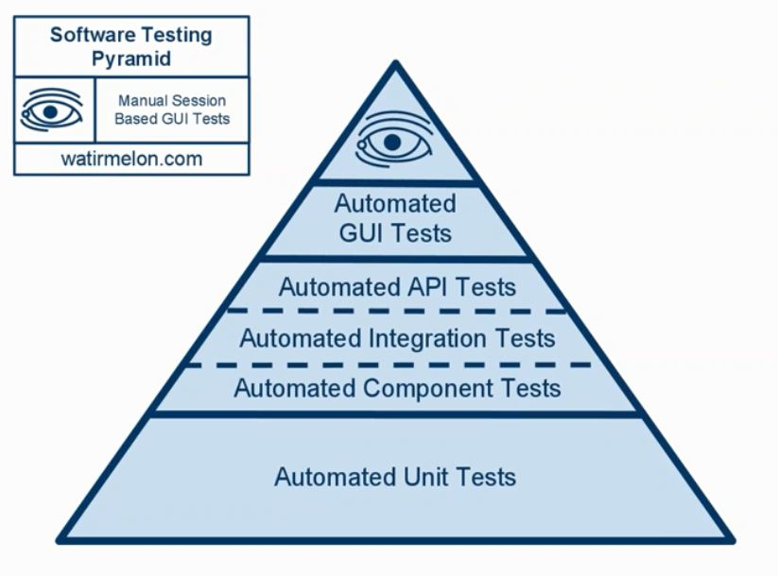
Why API / Service level testing
Test the core functionality
Improved test coverage
Time Effective – faster regression cycles
Find defects early
Language independent

Slide 9
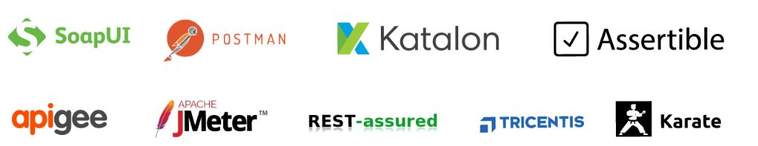
Tools

Slide 10
Introduction – Web Services
Any Service available over the web is a Web Service
WSDL defines the services provided by the service provider
Medium → HTTP / Internet
Format → XML / JSON
Client
Service Consumer
Request
Server
Service provider
Response

Slide 11
SOAP Web Services

Slide 12
SOAP Web Services
WSDL defines the services provided by the Web Service
The service is discoverable via UDDI
Clients uses stubs / proxies
Client uses Stub creates a SOAP request
SOAP request is sent to Web Service skeleton
Web Service skeleton invokes the Web Service
Web Service uses Skeleton prepares SOAP response
SOAP response is interpreted by Stub
Medium → HTTP / SMTP / FTP
Format → XML
Client
Service Consumer
SOAP Request
Server
Service provider
SOAP Response

Slide 13
SOAP Web Services
SOAP → Simple Object Access Protocol
SOAP Request contains
Envelope
Decoding rules (header)
Representation rules (body)
Fix XML format
Platform independent
Security is a BIG advantage
Can use any transport protocol for sending the messages
Medium → HTTP / SMTP / FTP
Format → XML
Client
Service Consumer
SOAP Request
Server
Service provider
SOAP Response

Slide 14
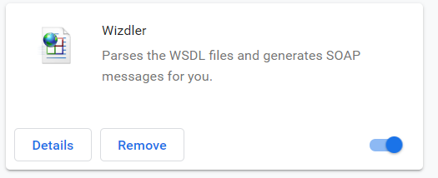

Practice – Web Service Testing
http://www.dneonline.com/calculator.asmx
https://www.dataaccess.com/webservicesserver/numberconversion.wso
http://webservices.oorsprong.org/websamples.countryinfo/CountryInfoService.wso

Slide 15
Rest Services

Slide 16
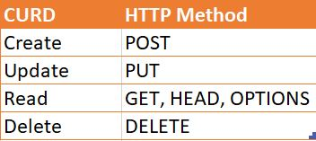
Resource
The key abstraction of information in REST is a resource.
REST architecture treats every content as a resource, resources can be:
Html pages
Images
Videos
Dynamic business data
Resource lifecycle management is done using HTTP methods
Every resource is uniquely identified by a URI
https://jsonplaceholder.typicode.com/users/1

Slide 17
Resource - Naming
REST uses URI to identify resources
As you traverse the path from more generic to more specific, you are navigating the data
URI
http://localhost/books/
http://localhost/books/ISBN-0011
http://localhost/books/ISBN-0011/authors

Slide 18
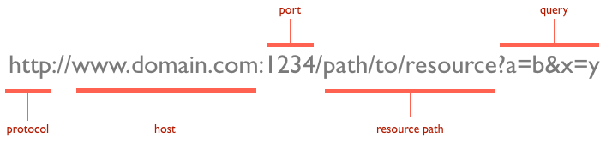
URL

Slide 19
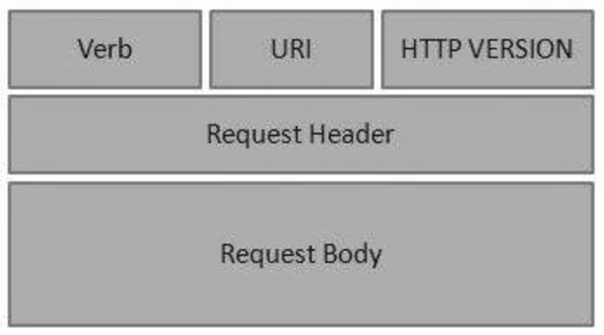
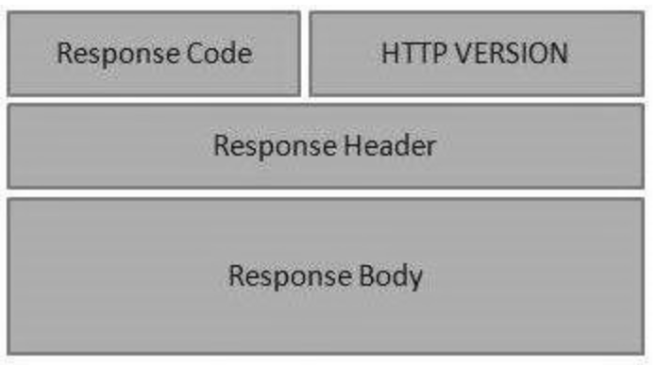
HTTP – Request and Response
GET – Gets the list of items
PUT – Updates the item
POST – Inserts the item
DELETE – Deletes the items
Request
Response

Slide 20
HTTP – Response Status Codes
CATEGORY | DESCRIPTION
1xx: Informational | Communicates transfer protocol-level information.
2xx: Success | Indicates that the REST web-service successfully carried out whatever action the client requested
3xx: Redirection | Indicates that the client must take some additional action in order to complete their request.
4xx: Client Error | This category of error status codes points the finger at clients.
5xx: Server Error | The server takes responsibility for these error status codes.

Slide 21
HTTP – Response Status Codes
200 — For Successful request.
201 — For successful request and data was created.
204 — For Empty Response.
400 — For Bad Request. The request could not be understood or was missing any required parameters.
401 — For Unauthorized access. Authentication failed or user does not have permissions for the requested operation.
403 — For Forbidden, Access denied.
404 — For data not found.
405 — For Method Not Allowed or Requested method is not supported.
500 — For Internal Server Error.
503 — For Service Unavailable.

Slide 22
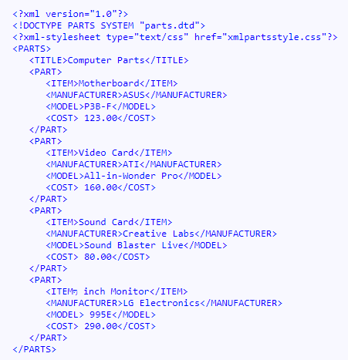
Data Formats - XML
Extensible Markup Language (XML) is used to describe data. The XML standard is a flexible way to create information formats and electronically share structured data via the public Internet, as well as via corporate networks.

Slide 23
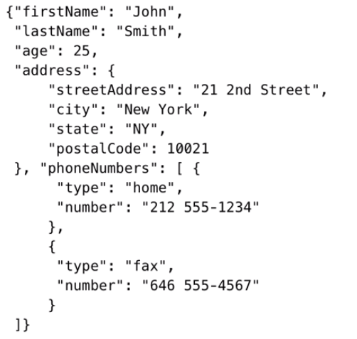
Data Formats - JSON
The JSON format is often used for serializing and transmitting structured data over a network connection.
It is used primarily to transmit data between a server and web application, serving as an alternative to XML

Slide 24
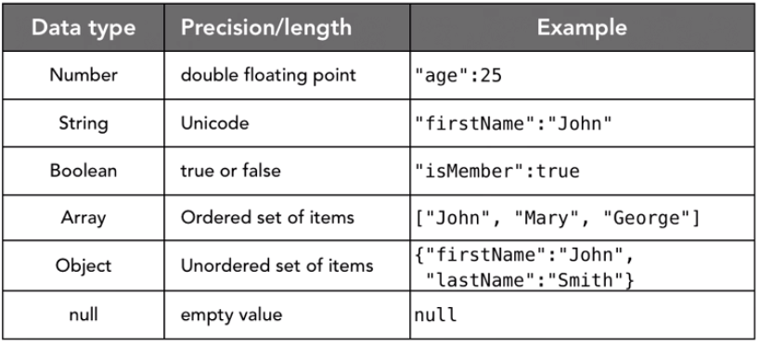
Data Formats – JSON Data types

Slide 25
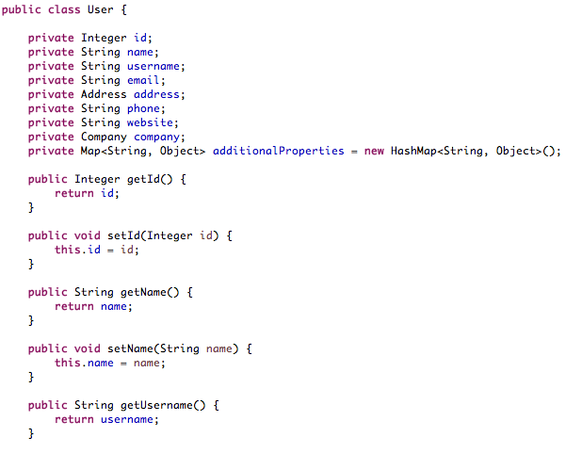
SERIALIZATION / DESERIALIZATION

Slide 26
REST ARCHITECTURE
REST → Representational state transfer
Transferring state representation to other software components
It’s an Architectural Style with constraints
Uniform interface
Client – server
Stateless
Cacheable
Layered System
Code on Demand (Optional)
Medium → HTTP
Format → XML/JSON/HTML/Text
Client
Service Consumer
HTTP Request
Server
Service provider
HTTP Response

Slide 27
Practice – REST Service Testing
http://api.mathjs.org/
https://api.github.com/users/test
https://jsonplaceholder.typicode.com/

Slide 28
Service Testing

Slide 29
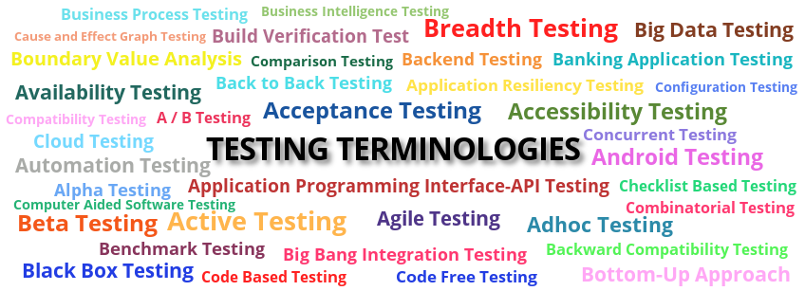
Testing types
Functional Testing
Regression Testing
Load Testing
Error Handling
Security Testing

Slide 30

General Defects
Issues observed when performing API testing are
Stress, performance, and security issues
Duplicate or missing functionality
Reliability issues
Improper messaging
Incompatible error handling mechanism
Multi-threaded issues
Improper errors

Slide 31

Responsibilities
API testing is conducted by QA Team
API testing is a form of Black box testing
API testing is conducted after the build is ready for testing
Source code is not involved in API testing
In API testing, the scope of testing is wide, so all the issues that are functional are considered for testing

Slide 32
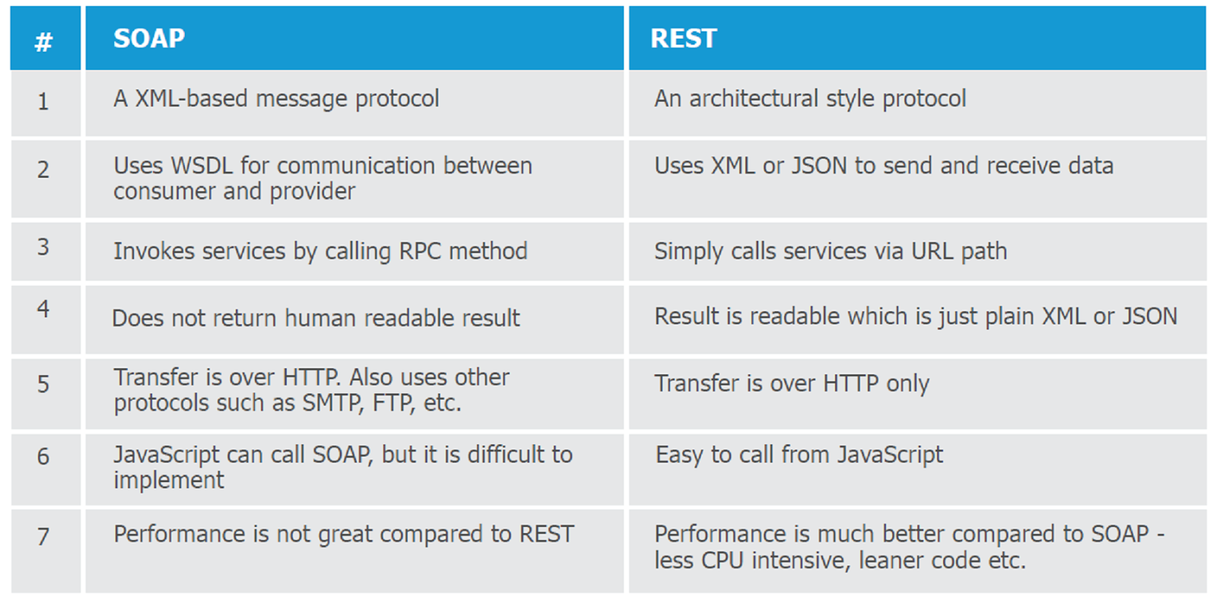
SOAP Vs REST

Slide 33
Thank you

